Slide 1
NODE.JS
(The Backend Of MERN Stack)
Lecture 10

Slide 2
Today’s Agenda
What is package manager ?
Introduction to NPM
Installing an NPM module
Running npm init
Using validator module
Using chalk module

Slide 3
What is a package manager ?
A package manager is a programming language’s tool to create project environments and easily import all the external dependencies.
It automates the finding, downloading, installing, configuring, upgrading, and removing of all the libraries for an application.
It also allows us to “package” our project and publish it for others.

Slide 4
Popular package managers
Language | Package Manager
Python | pip, conda
Java | maven ,gradle
Php | composer
JavaScript | npm,yarn
Ruby | rubygems

Slide 5
Introduction to npm
NPM (Node Package Manager) is the default package manager for Node.js and is written entirely in Javascript.
It was developed by Isaac Z. Schlueter, and was initially released on January 12, 2010.
As of now there are over 20 lakh npm packages available for downloading and using which surpasses any other language’s packages.

Slide 6
What does npm contain ?
NPM consists of two main parts:
a CLI (command-line interface) tool for publishing and downloading packages, and
an online repository that hosts JavaScript packages

Slide 7
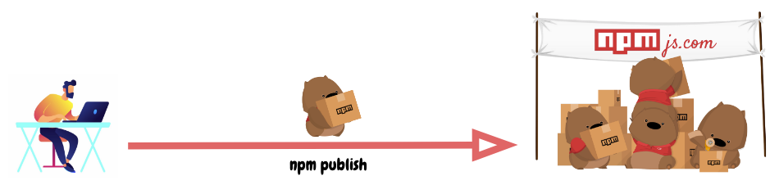
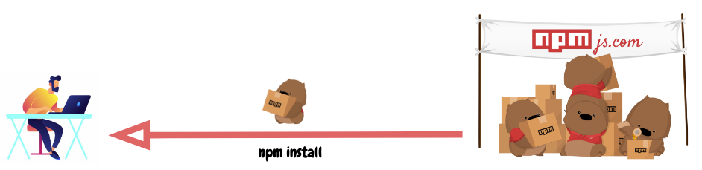
What is a repository ?
A repository is a fulfillment center that receives packages of goods from sellers (npm package authors) and distributes these goods to buyers (npm package users).

Slide 8
Third party modules
Third party modules or npm modules are modules that do not come with Node.js preinstalled but we can download/install them from npm repo and use them in our code.
Examples would be packages/modules which help us in validating data like emails and maybe even sending an email.

Slide 9
How do we install npm module ?
In order to install an npm module we need to take the following steps:
Create a application folder
Migrate into that folder in terminal
Run the command npm init which will create a package.json file in the app
Run the command npm install <module_name>.
For example: npm install validator
This will create a folder called node_modules in our app and install the mentioned module there . It will also add the dependencies of the module in package.json and package-lock.json files

Slide 10
Running npm init
Assume we created the app by the name of test:
cd test
npm init

Slide 11
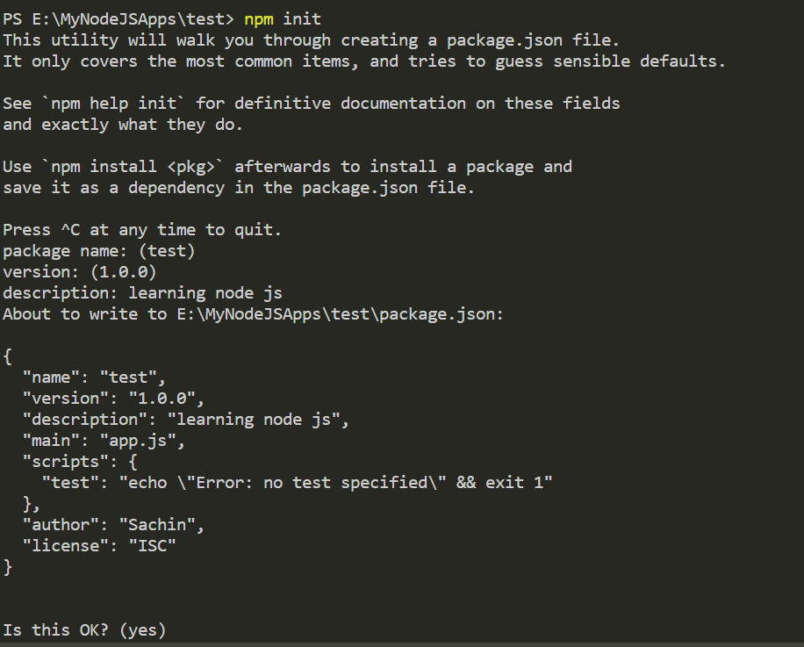
Output of npm init

Slide 12
What is package.json ?
A package.json is a JSON file in Node JS which is automatically created for us when we initialize a Node JS application using NPM.
It is called as a manifest file and stores the metadata of an application like application version, license and most importantly its dependencies.
It is always stored in the root directory of an application.

Slide 13
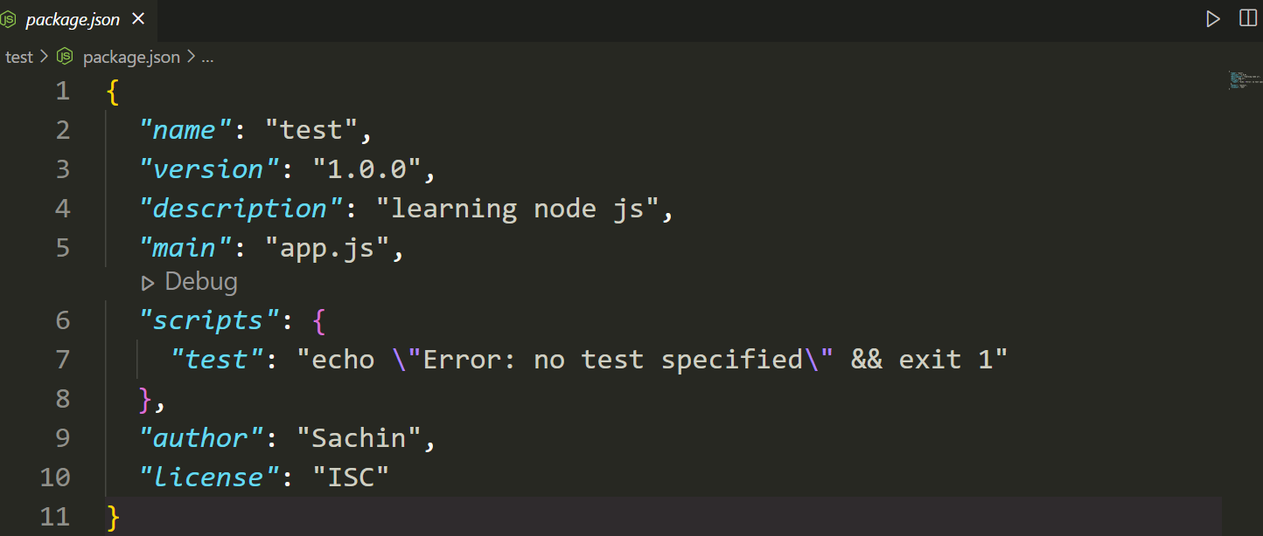
The generated package.json file

Slide 14
the validator module
The Validator module is popular for validation.
Validation is necessary to check whether the data is correct or not.
This module exactly does that by providing us functions like isEmail() , isDate() , isURL() , isEmpty() etc

Slide 15
Installing validator module
We can install this module by using the following command: inside our application folder:
npm install validator
After installing the validator module we will automatically get a new folder called node_modules and a new file called package-lock.json

Slide 16
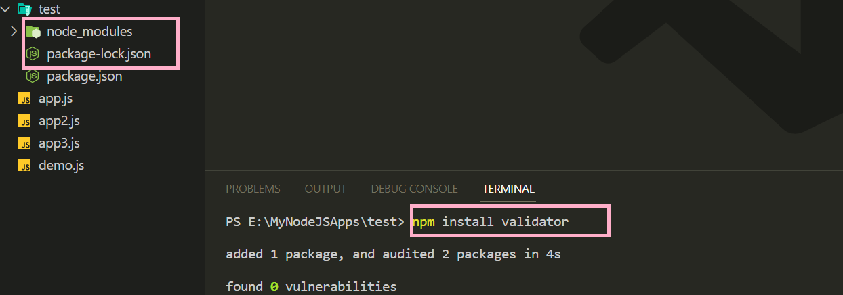
Installing validator module

Slide 17
What is package-lock.json ?
A package-lock.json file describes the exact versions of the dependencies as well as sub-dependencies used in an npm JavaScript project.
While package.json is a generic descriptive label, the package-lock.json is an ingredients table.

Slide 18
What is node_modules?
When we first install a package to a Node.js project, npm automatically creates the node_modules folder to store the modules needed for our project and the package-lock.json file
The node_modules folder contains every installed dependency for our project.
As we install more dependencies, the size of this folder will quickly grow.

Slide 19
Important validator functions
Validator module provides us following important functions:
isEmail()
isLowercase()
isEmpty()
isDate()
isURL()
The complete list of all the functions provided by Validator module can be found at :
https://www.npmjs.com/package/validator

Slide 20
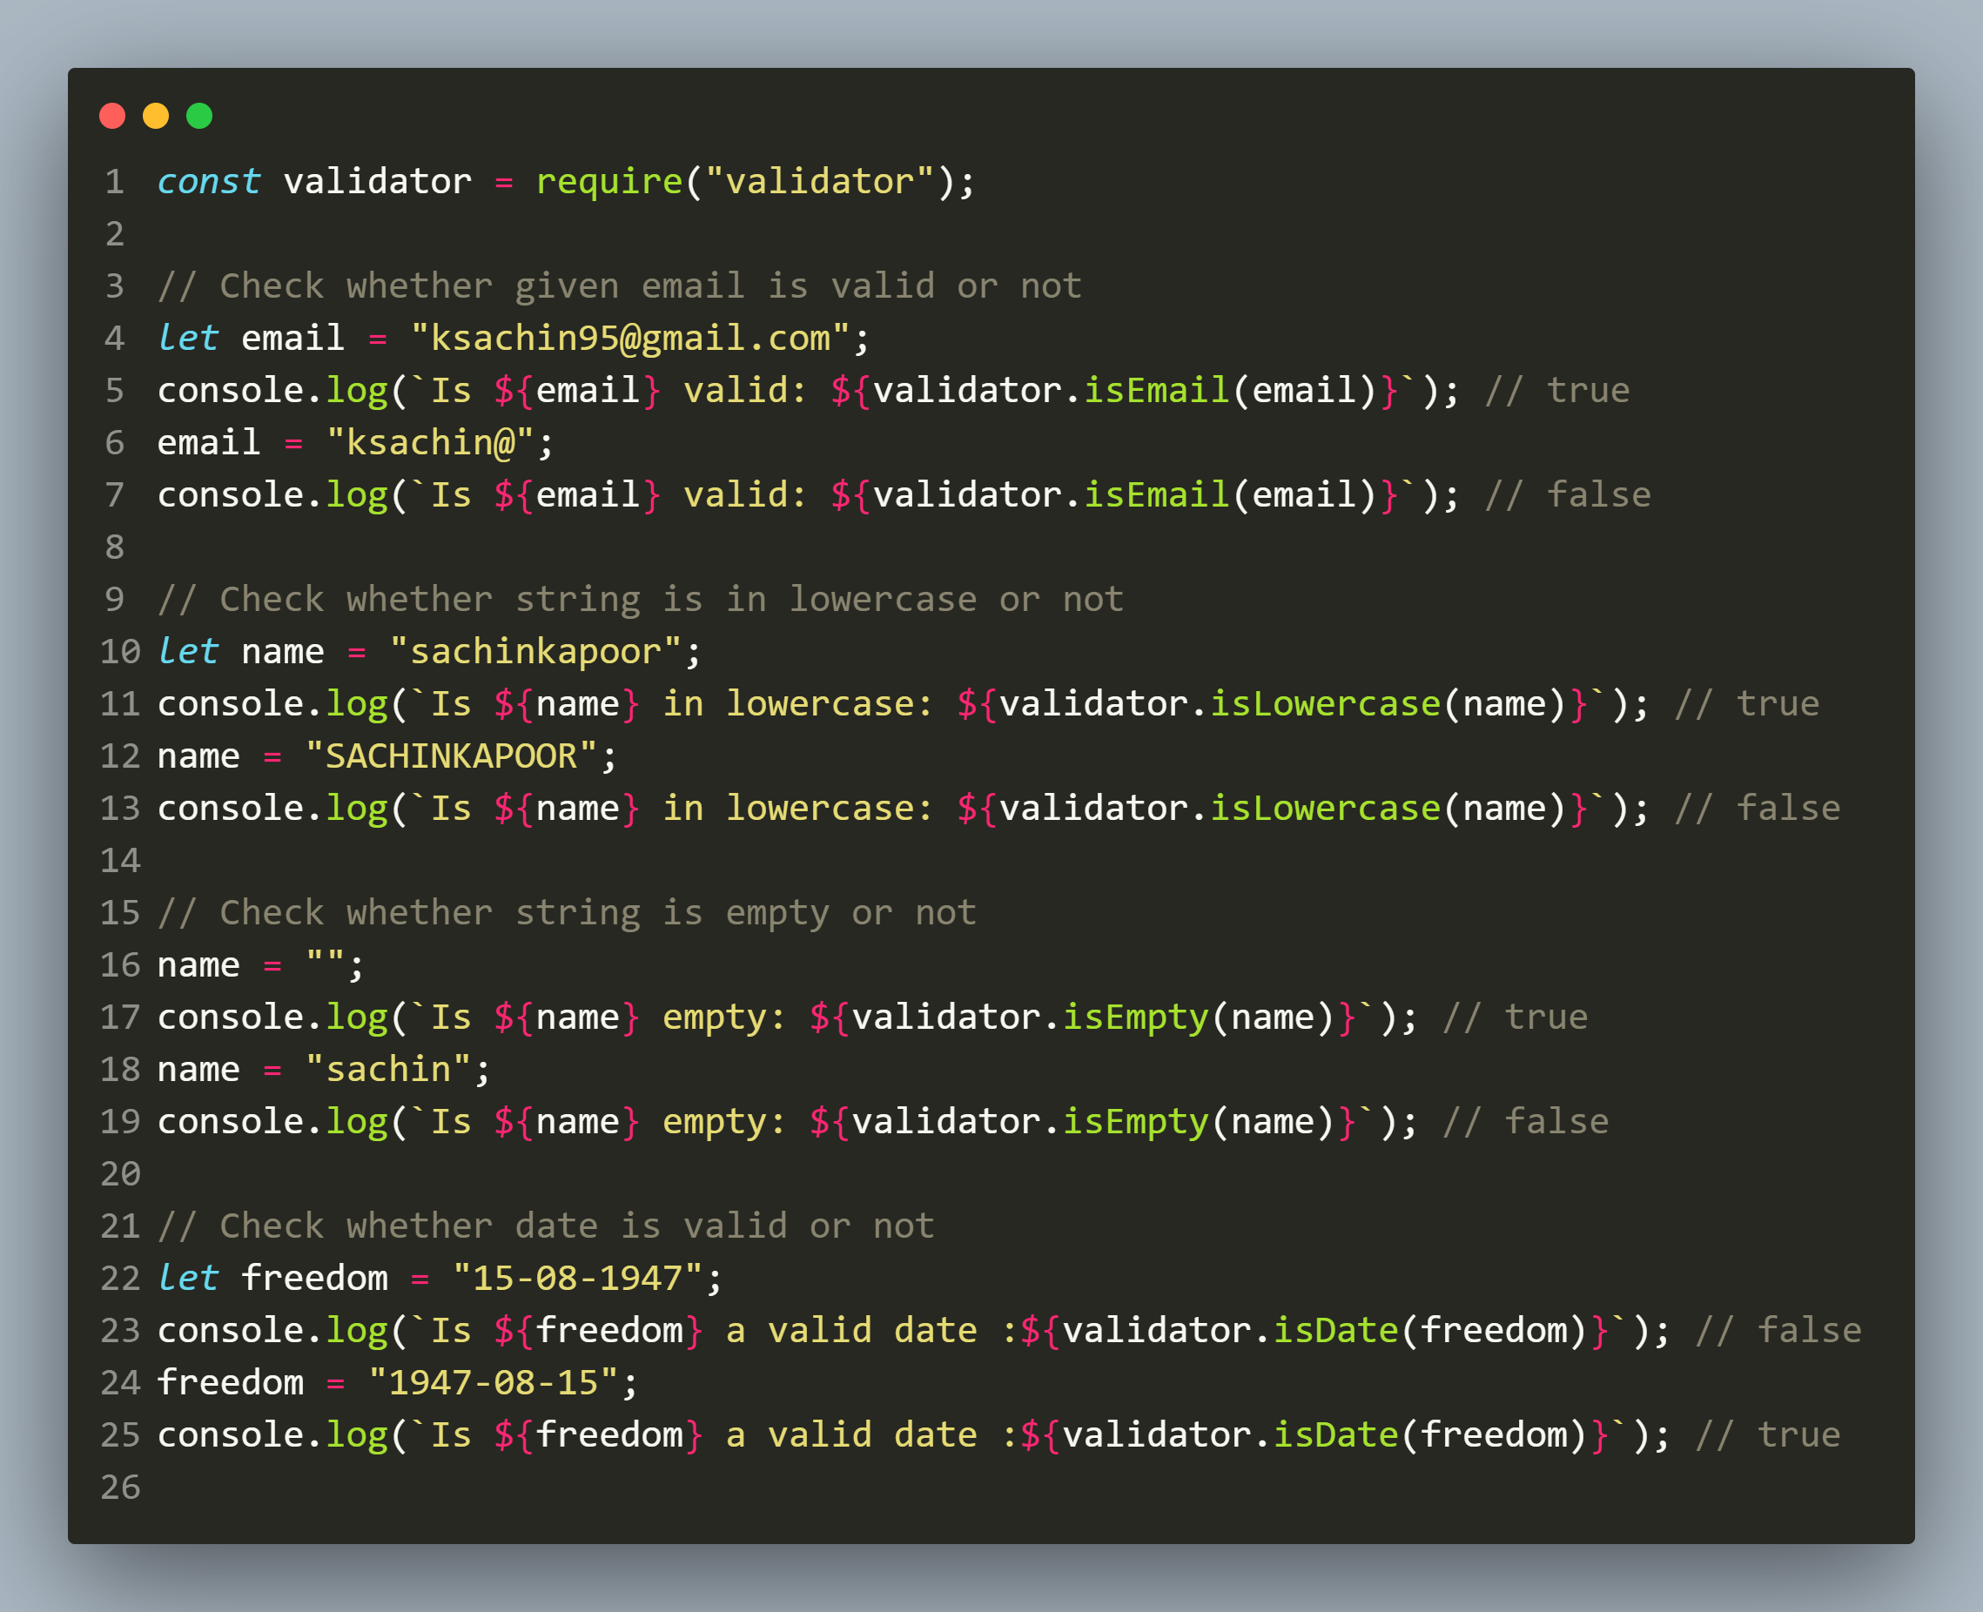
example

Slide 21
the chalk module
NPM chalk is a third-party Node.js module that is used to add color and styling to text on the command-line output.
Chalk supports multiple text styles with backgrounds supporting different colors and formatting.
For instance, we can show text in red color with a gray background that is bold and underlined.

Slide 22
Installing chalk module
We can install this module by using the following command: inside our application folder:
npm install chalk@4.1.2
Why we mentioned @4.1.2 ?
The latest version of chalk which is chalk 5.2.0 has changed to ESM and will not support require() as it is not a CommonJS module.
So we mentioned the version 4.1.2 while installing chalk as it is a CommonJS module and will support require() .

Slide 23
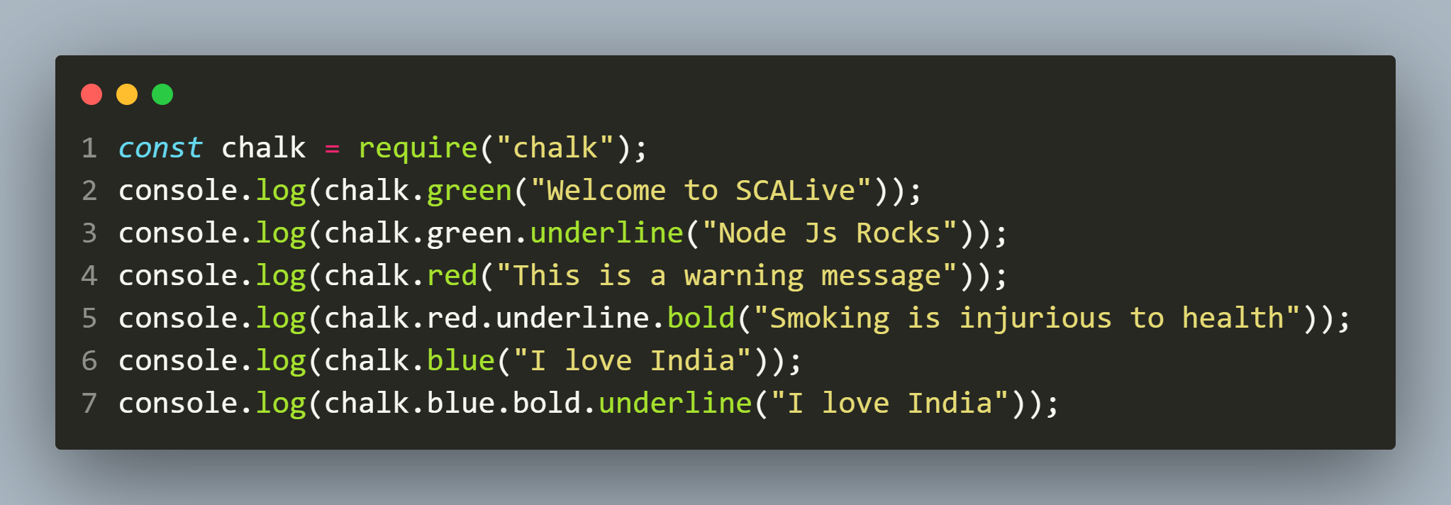
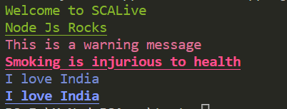
Example 1
app.js
output

Slide 24
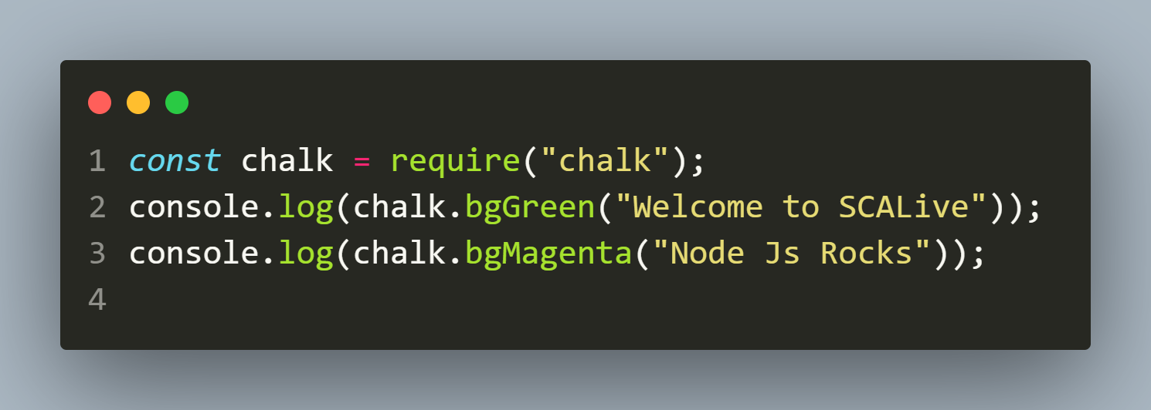

Example 2
app.js
output

Slide 25
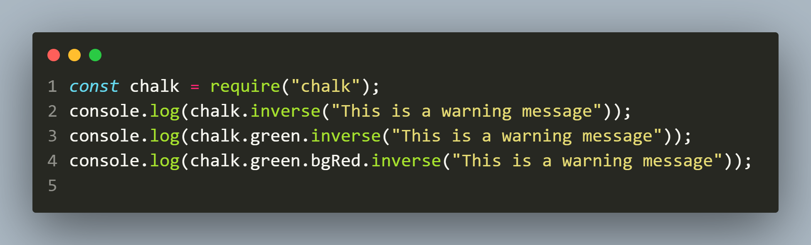

Example 3
app.js
output

